Slide 1
FIREWALLS
Name : Hemil Chovatiya
Enrollment number : 200303108003 Topic : Firewalls

Slide 2
INTRODUCTION
Firewalls control the flow of network traffic
Firewalls have applicability in networks where there is no internet connectivity
Firewalls operate on number of layers
It Can also act as VPN gateways
Active content filtering technologies

Slide 3
FIREWALL ENVIRONMENTS
There are different types of environments where a firewall can be implemented.
Simple environment can be a packet filter firewall
Complex environments can be several firewalls and proxies

Slide 4
VPN
VPN is used to provide secure network links across networks
VPN is constructed on top of existing network media and protocols
On protocol level IPsec is the first choice
Other protocols are PPTP, L2TP

Slide 5
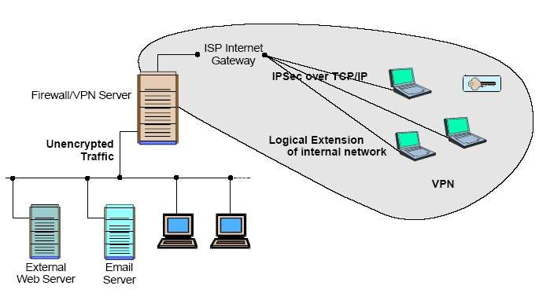
VPN

Slide 6
TYPES OF FIREWALLS
Firewalls fall into four broad categories
Packet filters
Circuit level
Application level
Stateful multilayer

Slide 7
PACKET FILTER
Works at the network level of the OSI model
Each packet is compared to a set of criteria before it is forwarded
Packet filtering firewalls is low cost and low impact on network performance

Slide 8
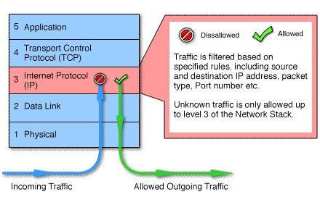
PACKET FILTERING

Slide 9
Packet-filtering Router
Applies a set of rules to each incoming IP packet and then forwards or discards the packet
Filter packets going in both directions
The packet filter is typically set up as a list of rules based on matches to fields in the IP or TCP header
Two default policies (discard or forward)
13

Slide 10
Advantages:
Simplicity
Transparency to users
High speed
Disadvantages:
Difficulty of setting up packet filter rules
Lack of Authentication
14

Slide 11
CONCLUSION
It is clear that some form of security for private networks connected to the Internet is essential
A firewall is an important and necessary part of that security, but cannot be expected to perform all the required security functions.

Slide 12
THANK YOU

